Slide 1


Slide 2
INTRODUCTION
Twitch con is a event for Content Creators on Twitch to meet their fans & thank them for their support by participating in various events.
It also helps creators to meet others creators to improvise their content or to collaborate with other creators.

Slide 3
E.R. Diagram

Slide 4
Participants
P_ID (pri key)
Name
Content_type
Contact_no
Email_address
E_code (F-key)
Management
E_ID(Pri key)
Name
Department
Contact_no
E_code (F-key)
Sponsors
S_ID (pri key)
Org_Name
Email_ address
Contact_no
E_ID (F-key)
Manages
Participates
Events
E_code(Pri key)
Event

Slide 5
STRUCTURE OF TABLE

Slide 6
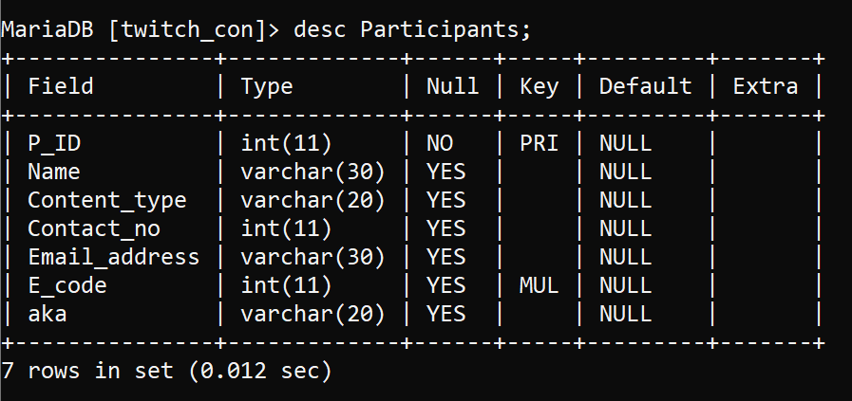
This Table contains details of all the participant’s participating and their events.
Syntax:- create table Participants(P_ID int primary key,Name varchar(30),Content_type varchar(20),Contact_no int,Email_address varchar(30),E_code int, aka varchar(20) ,foreign key ab(E_code) references Events(E_code);

Slide 7
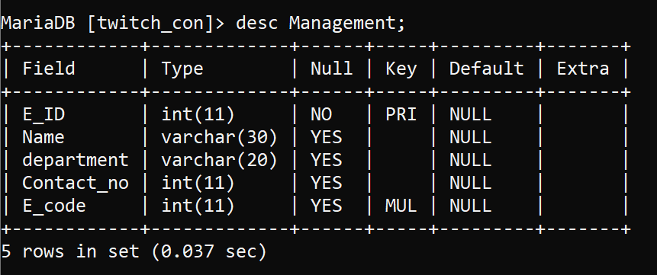
This table contains the information of Managers that make sure the event is executed as planned it contains all the information needed to contact the manager if any unplanned event takes place.
Syntax:- create table Management(E_ID int primary key,Name varchar(30),department varchar(20),Contact_no int,E_code int, foreign key ab(E_code) references Events(E_code));

Slide 8
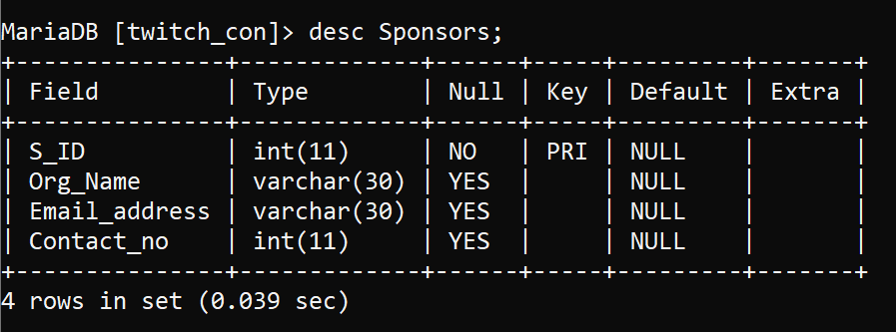
This table contains information of all the sponsor’s who are sponsoring this event.
Syntax:- Create table Sponsors(S_ID int primary key,Org_Name varchar(30),Email_address varchar(30),Contact_no int,E_ID int, foreign key ac (E_ID) references Management(E_ID));

Slide 9
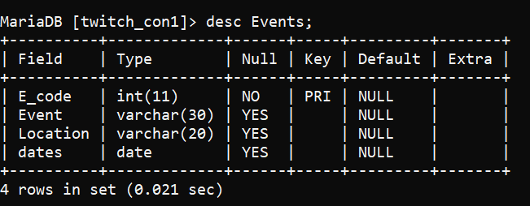
This table contains information of Events that are going to take place.
Syntax:- create table Events(E_code int primary key,Event varchar(30),Location varchar(20),Dates date);

Slide 10
CONTENTS OF TABLE

Slide 11
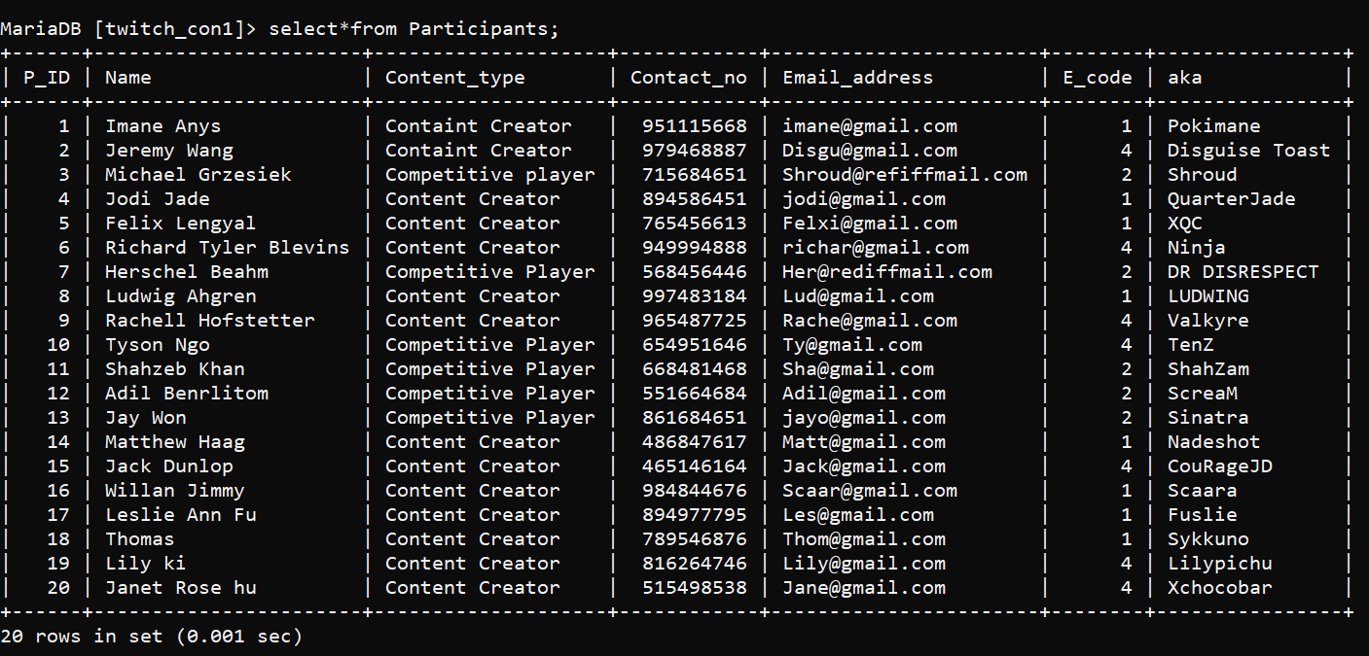
Table Participants
Syntax:-
Select * from Participants;

Slide 12
Populate table Participants:-
Insert into Participants
-> values
->(1,'Imane Anys' ,'Containt Creator', 951115668, 'imane@gmail.com',1, 'Pokimane' ),
->(2,'Jeremy Wang','Containt Creator’, 979468887,'Disgu@gmail.com’, 4,'Disguise Toast'),
->(3 , 'Michael Grzesiek' , 'Competitive player' , 715684651, 'Shroud@refiffmail.com' , 2 , 'Shroud '),
-> (4 , 'Jodi Jade', 'Content Creator' , 894586451 , 'jodi@gmail.com' , 1 , 'QuarterJade' ),
-> ( 5 , 'Felix Lengyal' , 'Content Creator' , 765456613 , 'Felxi@gmail.com' , 1 , 'XQC' ),
-> (6 , 'Richard Tyler Blevins' , 'Content Creator’ , 949994888 , 'richar@gmail.com’ , 4 , 'Ninja' ),
-> (7 , 'Herschel Beahm' , 'Competitive Player' , 568456446 , 'Her@rediffmail.com' , 2 , 'DR DISRESPECT' ),
-> (8 , 'Ludwig Ahgren' , 'Content Creator’ , 6154864187, 'Lud@gmail.com' , 1 , 'LUDWING' ),
-> (9 , 'Rachell Hofstetter' , 'Content Creator’ , 965487725 , 'Rache@gmail.com’ , 4 , 'Valkyre' ),
-> (10 , 'Tyson Ngo' , 'Competitive Player' , 654951646 , 'Ty@gmail.com’ , 4 , 'TenZ' ),
-> (11 , 'Shahzeb Khan' , 'Competitive Player’ , 668481468 , 'Sha@gmail.com' , 2 , 'ShahZam'),
-> (12 , 'Adil Benrlitom' , 'Competitive Player’ , 551664684 , 'Adil@gmail.com' , 2 , 'ScreaM' ),
-> (13 , 'Jay Won' , 'Competitive Player’ ,861684651 , 'jayo@gmail.com' , 2 , 'Sinatra' ),
-> (14 , 'Matthew Haag' , 'Content Creator’ , 486847617 , 'Matt@gmail.com' , 1 , 'Nadeshot' ),
-> (15 , 'Jack Dunlop' , 'Content Creator’ , 4651461644, 'Jack@gmail.com’ , 4 , 'CouRageJD' ),
-> (16 , 'Willan Jimmy' , 'Content Creator’ , 9848446766 , 'Scaar@gmail.com' , 1 , 'Scaara’),

Slide 13
(17 , 'Leslie Ann Fu' , 'Content Creator’ , 894977795 , 'Les@gmail.com' , 1 , 'Fuslie' ),
(18 , 'Thomas' , 'Content Creator’ , 789546876, 'Thom@gmail.com' , 1 , 'Sykkuno' ),
(19 , 'Lily ki' , 'Content Creator’ , 816264746 , 'Lily@gmail.com’ , 4 , 'Lilypichu' ),
(20 , 'Janet Rose hu' , 'Content Creator' , 515498538 , 'Jane@gmail.com’ ,4 ,'Xchocobar');

Slide 14
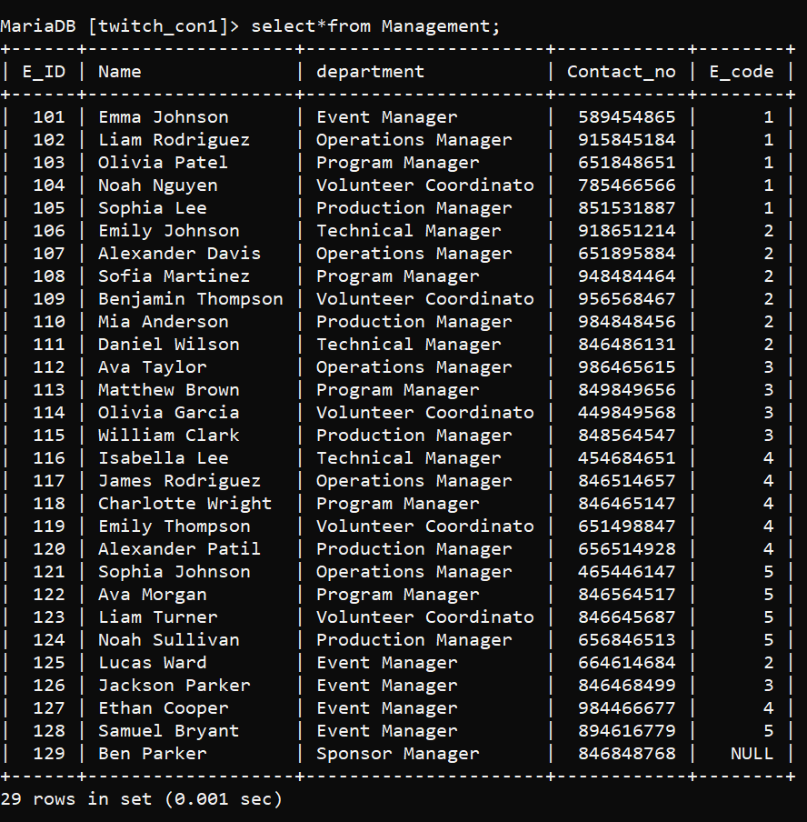
Table Management
Syntax:-
Select * from Management;

Slide 15
Populate table Management:-
insert into Management
-> values
-> (101,'Emma Johnson','Event Manager',589454865,1),
-> (102,'Liam Rodriguez','Operations Manager',915845184,1),
-> (103,'Olivia Patel','Program Manager',651848651,1),
-> (104,'Noah Nguyen','Volunteer Coordinator',785466566,1),
-> (105,'Sophia Lee','Production Manager',851531887,1),
-> (106,'Emily Johnson','Technical Manager',918651214,2),
-> (107,'Alexander Davis','Operations Manager',651895884,2),
-> (108,'Sofia Martinez','Program Manager',948484464,2),
-> (109,'Benjamin Thompson','Volunteer Coordinator',956568467,2),
-> (110,'Mia Anderson','Production Manager',984848456,2),
-> (111,'Daniel Wilson','Technical Manager',846486131,2),
-> (112,'Ava Taylor','Operations Manager',986465615,3),
-> (113,'Matthew Brown','Program Manager',849849656,3),
-> (114,'Olivia Garcia','Volunteer Coordinator',449849568,3),

Slide 16
-> (115,'William Clark','Production Manager',848564547,3),
-> (116,'Isabella Lee','Technical Manager',454684651,4),
-> (117,'James Rodriguez','Operations Manager',846514657,4),
-> (118,'Charlotte Wright','Program Manager',846465147,4),
-> (119,'Emily Thompson','Volunteer Coordinator',651498847,4),
-> (120,'Alexander Patil','Production Manager',656514928,4),
-> (121,'Sophia Johnson','Operations Manager',465446147,5),
-> (122,'Ava Morgan','Program Manager',846564517,5),
-> (123,'Liam Turner','Volunteer Coordinator',846645687,5),
-> (124,'Noah Sullivan','Production Manager',656846513,5),
-> (125,'Lucas Ward','Event Manager',664614684,2),
-> (126,'Jackson Parker','Event Manager',846468499,3),
-> (127,'Ethan Cooper','Event Manager',984466677,4),
-> (128,'Samuel Bryant','Event Manager',894616779,5);

Slide 17
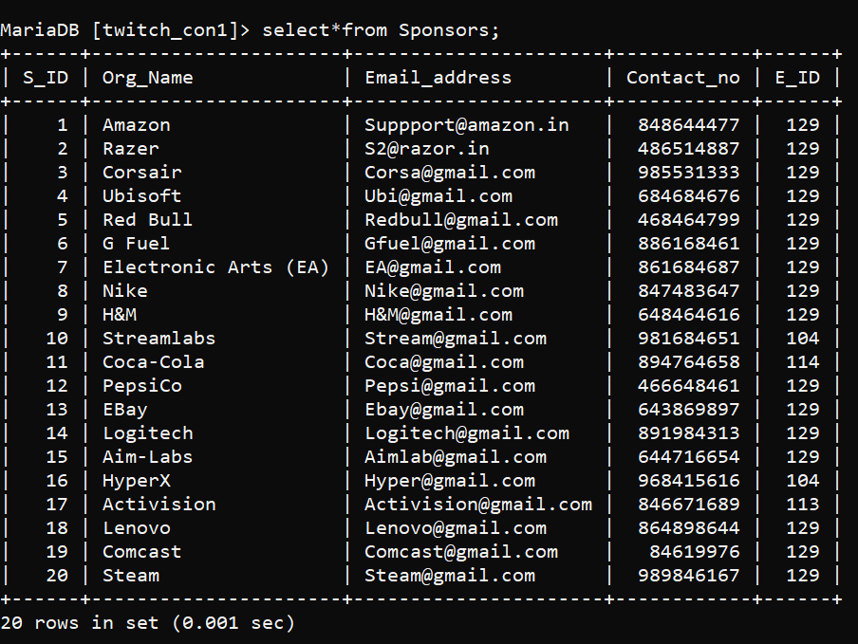
Table Sponsors
Syntax:-
Select * from Sponsors;

Slide 18
Populate table Sponsors:-
insert into Sponsors
-> values
-> (1,'Amazon','Suppport@amazon.in',848644477, 129),
-> (2,'Razer','S2@razor.in',486514887, 129 ),
-> (3,'Corsair','Corsa@gmail.com',985531333, 129 ),
-> (4,'Ubisoft','Ubi@gmail.com',684684676, 129),
-> (5,'Red Bull','Redbull@gmail.com',468464799, 129),
-> (6,'G Fuel','Gfuel@gmail.com',886168461, 129),
-> (7,'Electronic Arts (EA)','EA@gmail.com',861684687, 129),
-> (8,'Nike','Nike@gmail.com’, 847483647, 129),
-> (9,'H&M','H&M@gmail.com',648464616, 129),
-> (10,'Streamlabs','Stream@gmail.com',981684651,104),
-> (11,'Coca-Cola','Coca@gmail.com',894764658,114),
-> (12,'PepsiCo','Pepsi@gmail.com',466648461, 129),
-> (13,'EBay','Ebay@gmail.com',643869897, 129),
-> (14,'Logitech','Logitech@gmail.com',891984313, 129),
-> (15,'Aim-Labs','Aimlab@gmail.com',644716654, 129),
-> (16,'HyperX','Hyper@gmail.com',968415616,104),
-> (17,'Activision','Activision@gmail.com',846671689,113),
-> (18,'Lenovo','Lenovo@gmail.com',864898644, 129),
-> (19,'Comcast','Comcast@gmail.com',84619976, 129),
-> (20,'Steam','Steam@gmail.com',989846167, 129);

Slide 19
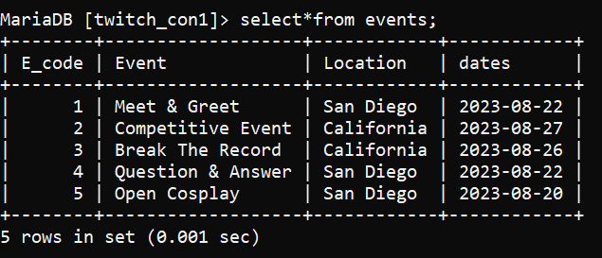
Table Events
Syntax:-
select * from Events;

Slide 20
Populate table Events:-
insert into Events
-> values
-> (1,'Meet & Greet’,’San Deigo’,’2023-08-22’),
-> (2,'Competitive Event’,’California’,’2023-08-27),
-> (3,'Break The Record’,’ California’,’2023-08-26’),
-> (4,'Question & Answer’, ’San Deigo’,’2023-08-22),
-> (5,'Open Cosplay’, ’San Deigo’,’2023-08-20’);

Slide 21
SUBQUERIES

Slide 22
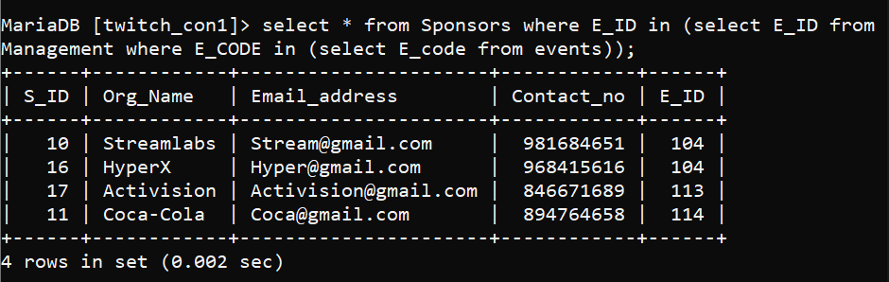
Q1) Show details of sponsor’s who are being managed by event managers.
Ans:-
select * from Sponsors where E_ID in (select E_ID from Management where E_CODE in (select E_code from events));

Slide 23
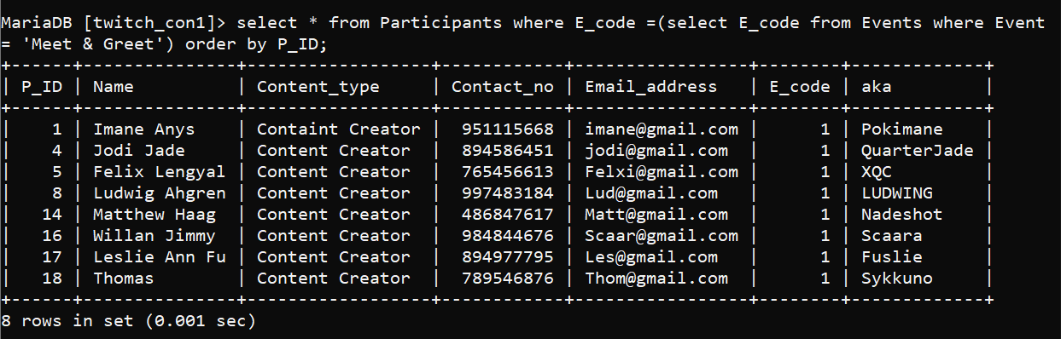
Q2) Show all details of Participants Participating in ‘Meet & Greet’ events order by P_ID.
Ans:-
select * from Participants where E_code =(select E_code from Events where Event = 'Meet & Greet') order by P_ID;

Slide 24
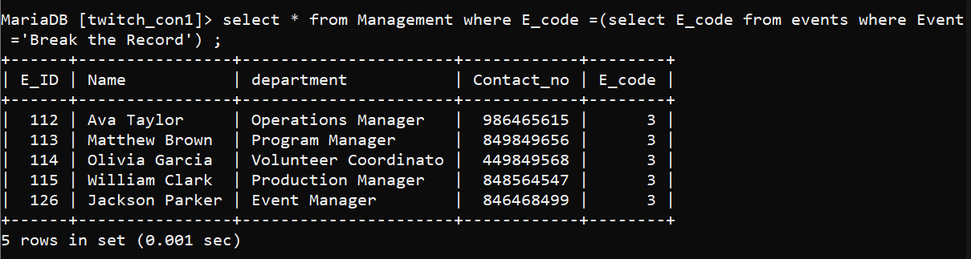
Q3) Show all details of Managers, Managing the ‘Break The Record’ Event.
Ans:-
select * from Management where E_code =(select E_code from events where Event ='Break the Record') ;

Slide 25
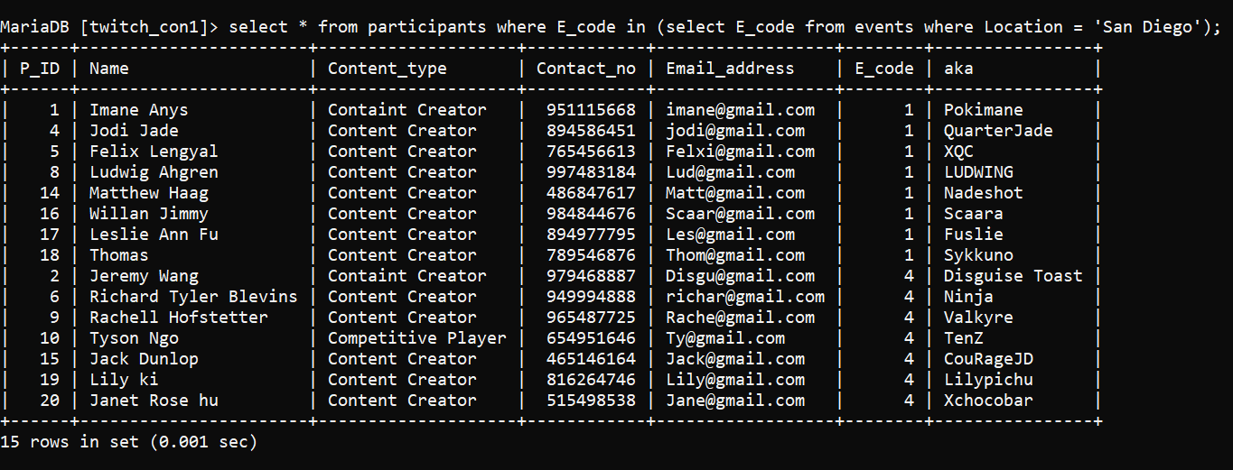
Q4) Show the details of Participants participating in San Deigo.
Ans:-
select * from participants where E_code in (select E_code from events where Location = 'San Diego');

Slide 26
JOINS

Slide 27
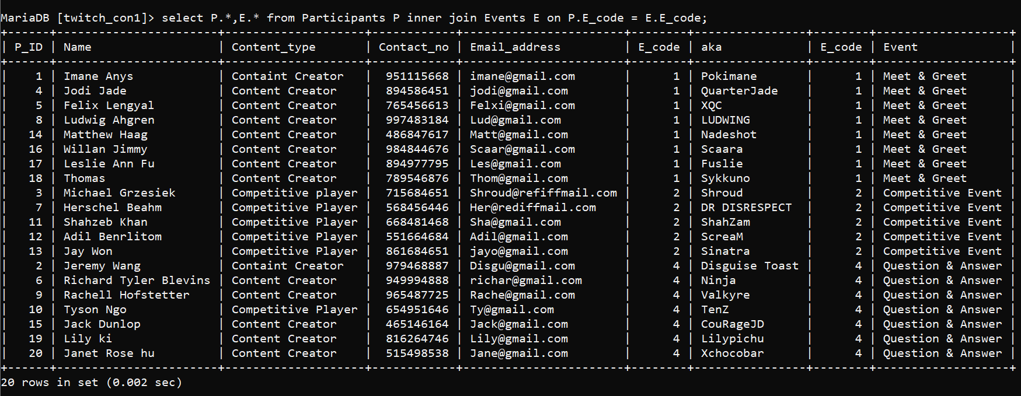
Q) Display Participants along with their events.
Ans:-
select P.*,E.* from Participants P inner join Events E on P.E_code = E.E_code;

Slide 28
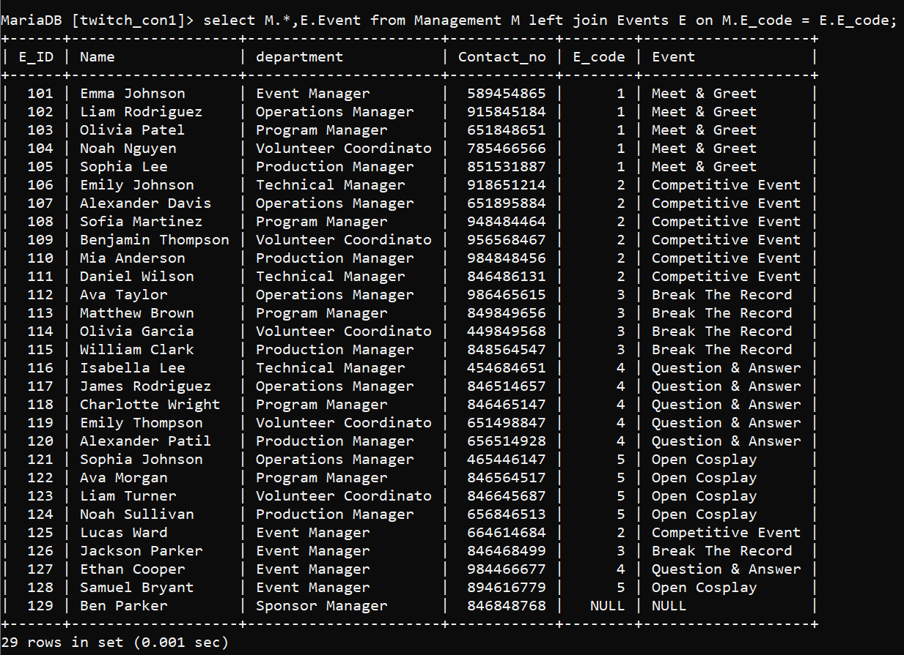
Q) Show details of Managers with their associated Events.
Ans:-
select M.*,E.Event from Management M left join Events E on M.E_code = E.E_code;

Slide 29
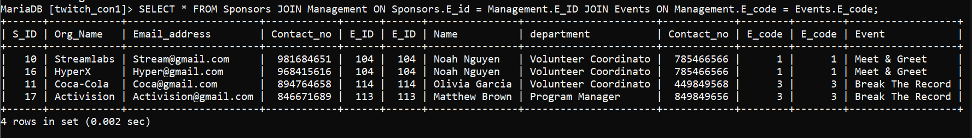
Q) Show details of Managers organizing Events & Sponsors
Ans:- SELECT * FROM Sponsors JOIN Management ON Sponsors.E_id = Management.E_ID JOIN Events ON Management.E_code = Events.E_code;

